Slide 1

Rascal: Small-Scale Demonstration of Proximity Operations and Rendezvous
Jennifer Babb
Bryant Gaume
Tom Moline
Tyler Olson
Nate Richard

Slide 2
Mission Overview
Subsystem Overviews
Risk Overview
Conclusion

Slide 3
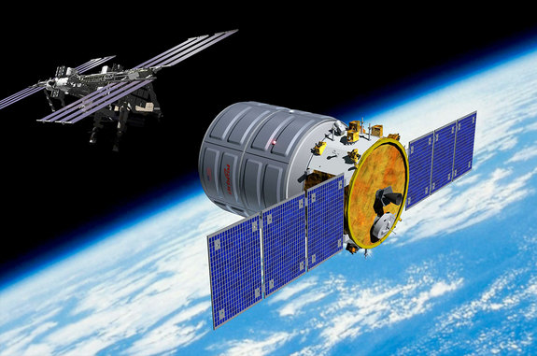
Rascal Mission
Demonstrate the performance of rendezvous and proximity operations (RPO) and the inspection of a cooperating Resident Space Object (RSO) within a small spacecraft architecture.
The RPO demonstration will consist of:
Spacecraft separation
Stationkeeping
Rendezvous
Inspection
CAVEAT

Slide 4
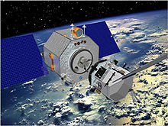
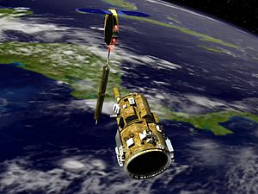
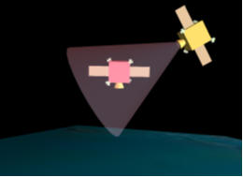
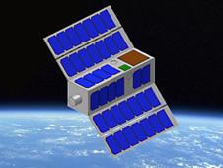
Mission Relevance
Orbital Express-
300 Million Dollars
DART-
95 Million Dollars
Previous RPO missions have come at a prohibitive cost.
Relates directly to NASA Strategic Goal 3.3.

Slide 5
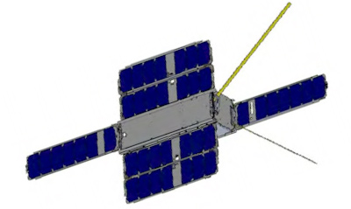
Mission Architecture
Fits within 6U CubeSat architecture (10x20x30cm).
One 3U (10x10x30cm) Primary/Interceptor Spacecraft
Providing a 1.5U payload.
Fits within Boeings Colony-II Bus
One 3U Secondary/Target Spacecraft
Will have a mission lifetime of 2 weeks
Designed to be as simple and easy to manage as possible

Slide 6

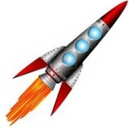
Orient for Separation
LV Separation and Checkout
Separation
Inspection Distance Checkout
Move to maximum relative separation
Launch
Stationkeep at maximum relative distance
Extended Ops and Deorbit
Repeat mission without visual aids
Inspection
Rendezvous

Slide 7
Functional Block Diagram
Primary Spacecraft
Secondary Spacecraft
Primary Aids
PLD
Flash Memory
PWR
Imager
CDH
Regulator
Batteries
Contact Switch
CDH
ADC
PRP
Microcontroller
Nutation Dampening
Thruster Block
Firing Circuit
COM
SEP
SEP
RFID Chip
Solenoid
Primary Attachment
Secondary Attachment
Power Transfer
Boeing
Patch Rx Antenna
SSRL Ground Station

Slide 8
Spacecraft Layout

Slide 9
Mission Overview
Subsystem Overviews
Risk Overview
Conclusion

Slide 10
Secondary Attitude Determination and Control (ADC) Subsystem
The secondary spacecraft will utilize a nutation damping system capable of reducing slew rate to 10 ⁰/s within one orbit after separation.
INSERT COOL NUTATION DAMPING BUDGET

Slide 11
Primary ADC Subsystem
Responsible for developing control algorithms and for all orbit planning/analysis.
Control algorithms and orbit analysis are defined relative to target spacecraft within CW Coordinate Frame.

Slide 12
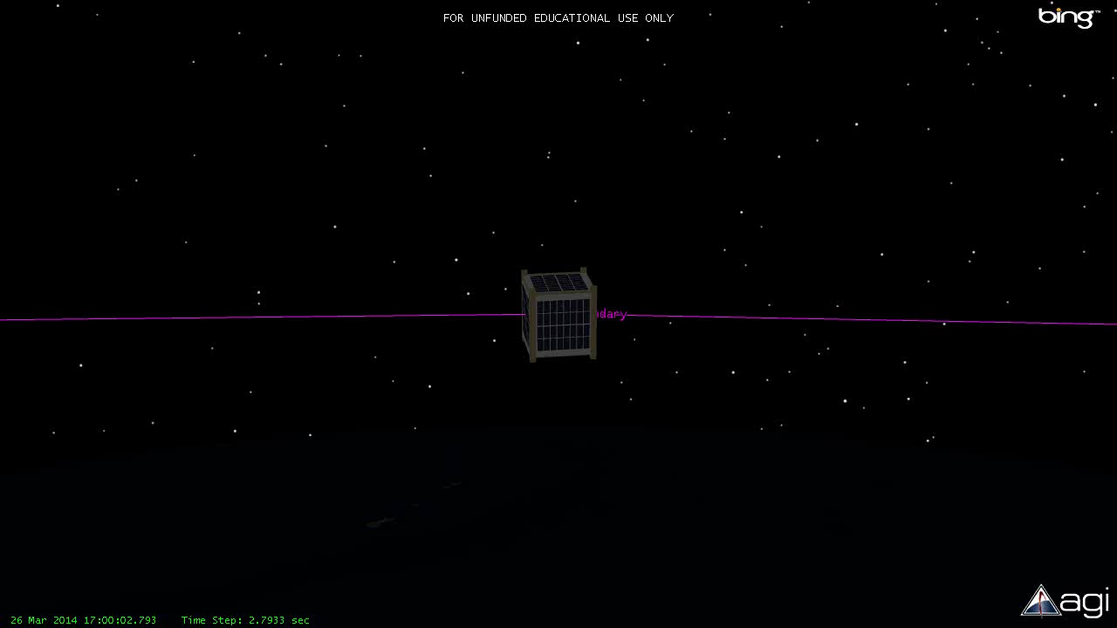

Slide 13
Delta-V Budget

Slide 14
Power Subsystem
Secondary spacecraft has no power generation to reduce cost and complexity
Battery Voltage (V) | 3.6
Battery Current Rating (mA-hr) | 9000
Maximum Current Draw (mA) | 200
String Voltage (V) | 3.6
Number of Strings | 36
Total Battery Pack Current (mA-Hr) | 324000
Total Battery Pack Power (W-Hr) | 1166400
Total Orbits with LEDs On | 550.8
Total Days with LEDs On | 35.8
Required to last a minimum of 14 days for cooperative maneuvers
Largest continuous power draw comes from visual aid LEDs
Uses non-rechargeable lithium Thionyl Chloride C sized batteries for their high energy density

Slide 15
Propulsion Subsystem
The Rascal primary spacecraft will employ a cold-gas propulsion unit to conduct orbital maneuvers.
The propulsion subsystem provides 3-degrees-of-freedom translation capability through the use of six thruster pairs
The propulsion unit consists of two main subassemblies, the Tank Assembly and the Thruster Assembly, which are separated within the spacecraft for interface and integration purposes.
X+
Y+
X-
Y-
Tank Assembly
SLU Payload
Z+
Z-
Thruster Assembly
Z+
Boeing Colony-II Bus
Y+
Y-
X+
Z-
X+

Slide 16
Propulsion Subsystem
Main Tank
Tank Assembly
Expansion Valve
Expansion Chamber
Control valve
Thruster Valve
Thruster Assembly
Thruster Exit

Slide 17
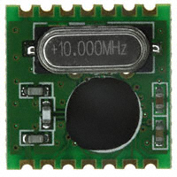
Communication Subsystem
The primary spacecraft will use the communications system made available on the Colony-II bus
The secondary spacecraft communication system will be developed at SLU
Only needs to receive
(per mission requirements)
Consists of an RFID chip and UHF patch antenna

Slide 18
Link Budget
Assumptions: 300 km circular orbit, 5° above horizon
 | Units | Values | Comments & References
Uplink Frequency | MHz | 433 | UHF Uplink
Station TX power | dB | 16.9897
Gain | dBi | 15
Ground Station Losses | dB | 3.6 | Internal Loss on the transmission lines
EIRP | dBW | 28.3897
Pointing Loss | dB | 0.2
Polarization Loss | dB | 0.2
Atmospheric Loss | dB | 2.1
Ionospheric Loss | dB | 0.4
Propagation Range | km | 1500
Path Loss | dB | 148.71
Isotropic Signal @ S/C | dBW | -123.22
G/T | dB-K | -21.17
S/N₀ | dBHz | 84.01
Data Rate, B | dB | 36.02
E_{b}/N₀ | dB | 47.99
Bit Rate Error |  | 0.0000

Slide 19
Data Budget
30 fps camera
640x480 resolution
24 bit color
16 GB of storage
PLD
SPI
16GB SD Card
Imager
Image Processor
I2C
µController

Slide 20
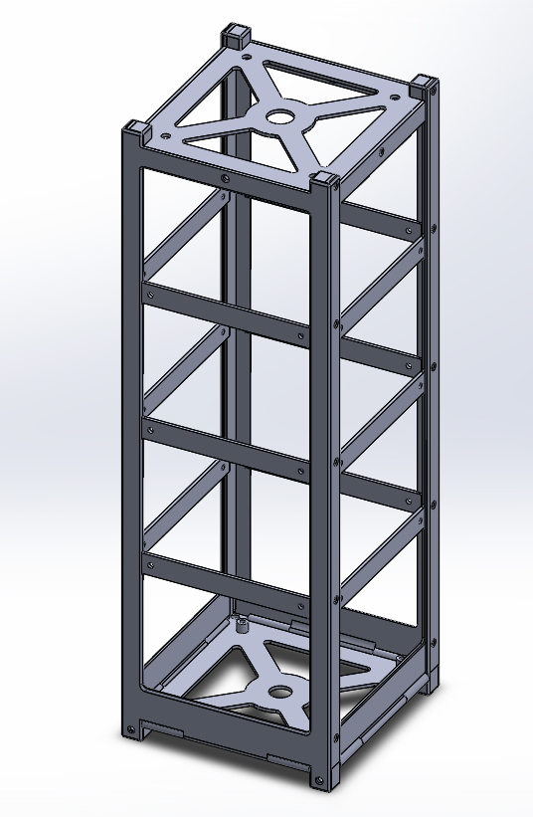
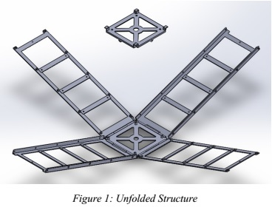
Structures Subsystem
Secondary spacecraft’s structure and separation system will be developed in house.

Slide 21
Secondary Structure Mass Budget
Total Allotted Mass: 4,000 g
The ADC subsystem is allotted about 1.5 kg to develop the nutation damping system that will meet mission requirements.

Slide 22
Separation
Interface Plate
The mission requires two independent 3U spacecrafts that integrate into a single 6U bus.
Separation of the two spacecrafts is necessary for mission success.
Testing has commenced on the effectiveness of using solenoids for the separation system.
Structural Support
Separation Port
Spring
Solenoid
Powering System
Structural Support
Magnified View

Slide 24
Mission Overview
Subsystem Overviews
Risk Overview
Conclusion

Slide 25
Mission Risks
Spacecraft unable to separate
Collision during inspection stationkeeping
Unable to rendezvous during cooperative maneuvers
Unable to rendezvous during non-cooperative maneuvers
Collision during rendezvous
Likelihood | 5
 | 4
 | 3
 | 2 |  |  |  | 2, 3, 4 | 5
 | 1 |  |  |  |  | 1
 |  | 1 | 2 | 3 | 4 | 5
 |  | Consequences

Slide 26
Mission Overview
Subsystem Overviews
Risk Overview
Conclusion

Slide 27
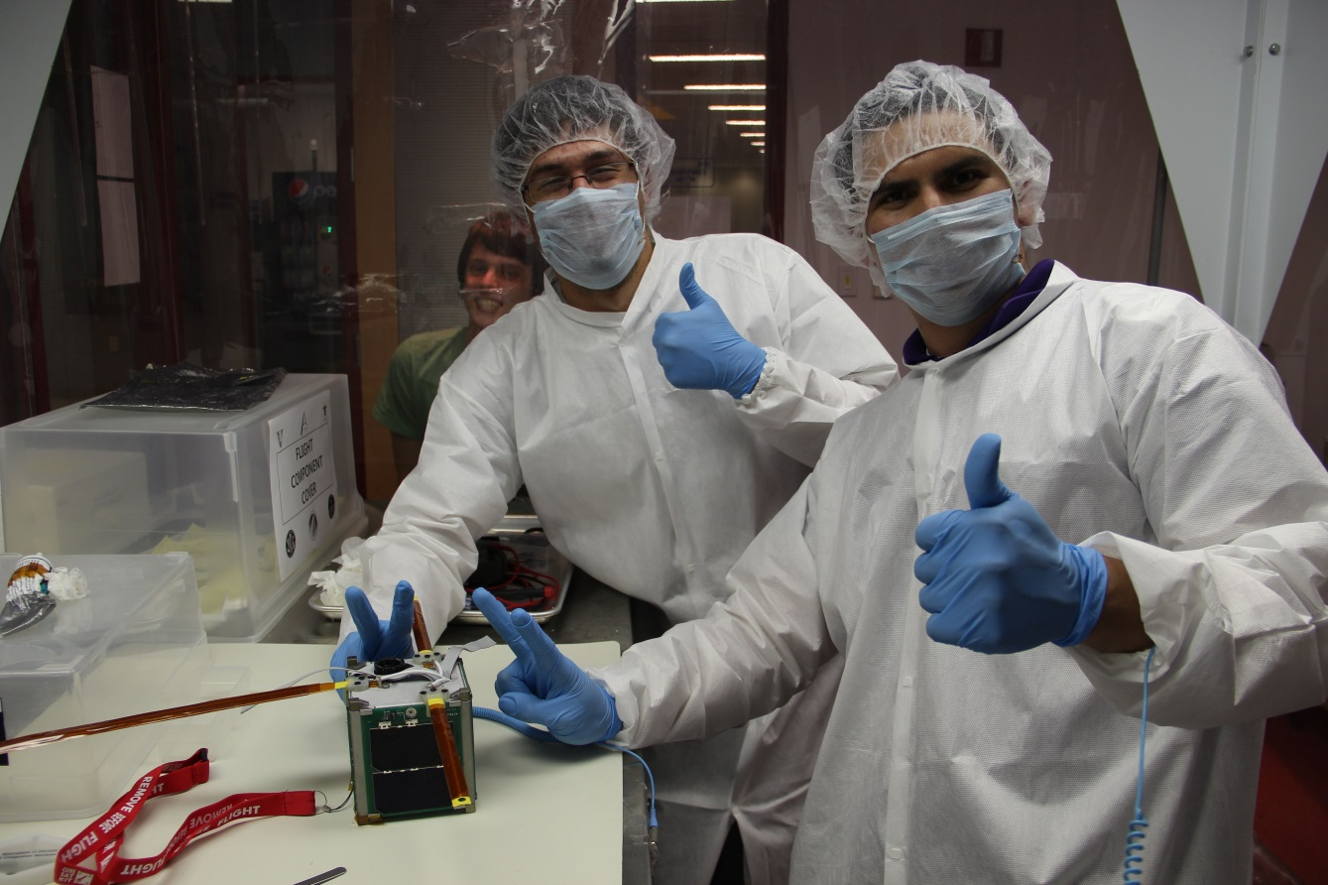
Results
How has the Rascal mission changed?
Is the Rascal mission still relevant?
Is the Rascal mission still feasible?

Slide 28
QUESTIONS?

